Slide 2
Lunch!
30 mins

Slide 3
Configure SSO
15 mins
Notes:
Speaker: Adib

Slide 4

Spring Apps Gateway – Commercial filters
Provides several custom filters in addition to those included in the open-source project
Rate Limiting Filter
Circuit Breaker Filter
Single Sign-on Authorized Endpoint – Security Filter
Scope Authorization – Security Filter
Role-Based Access Control – Security Filter
Token Relay – Security Filter
Request / Response Modification Filter
Client Certificate Authorization Filter
…
Link to Commercial Route Filters
Notes:
[Explain a few of the commercial filters.]
Let’s now explore how the SSO commercial filter makes integration with Azure AD easy.

Slide 5

Demo 5 Configure SSO
AAD application
Configure single sign-on
Log in to the app and place order

Slide 6







SSO integration with OIDC
Configurable single sign-on (SSO) integration with your preferred identity provider (IDP)
Authenticated?
Spring Apps Gateway
Backend APIs
Identity
Catalog
Payment
Yes
Cart
No
Order
Azure Active Directory
Notes:
We are going to enable single sign-on for this line of business application.
When the request arrives at the Spring Apps Gateway, we will check if the calling user is authenticated or not.
If not authenticated, we will direct the call to the Azure Active Directory, which will authenticate the user and issue a JWT or identity token.
Upon successful authentication, the request is directed to the requested API and the managed Spring Apps Gateway relays the JWT token to the backend API Controller.
Let’s see how to do this.

Slide 7
Token relay
Enabling Token Relay, Spring Apps Gateway passes currently authenticated user’s identity token to the app when the user accesses the app’s route
Authentication: Bearer xznjs….
Spring Apps Gateway
Backend APIs
Authentication: Bearer xznjs….
Identity
Catalog
Payment
Cart
Order
Cookie Session
Azure Active Directory
Notes:
So how did this happen?
We did not write any code.
We simply configured.
We provisioned and configured an app at the Azure Active Directory and configured Single Sign-On in the Spring Apps Gateway. We enabled Single Sign-On and turned on Security Token Relay.
By enabling Token Relay, Spring Apps Gateway passes the currently authenticated user’s identity token to the app when the user accesses the app’s route.

Slide 8
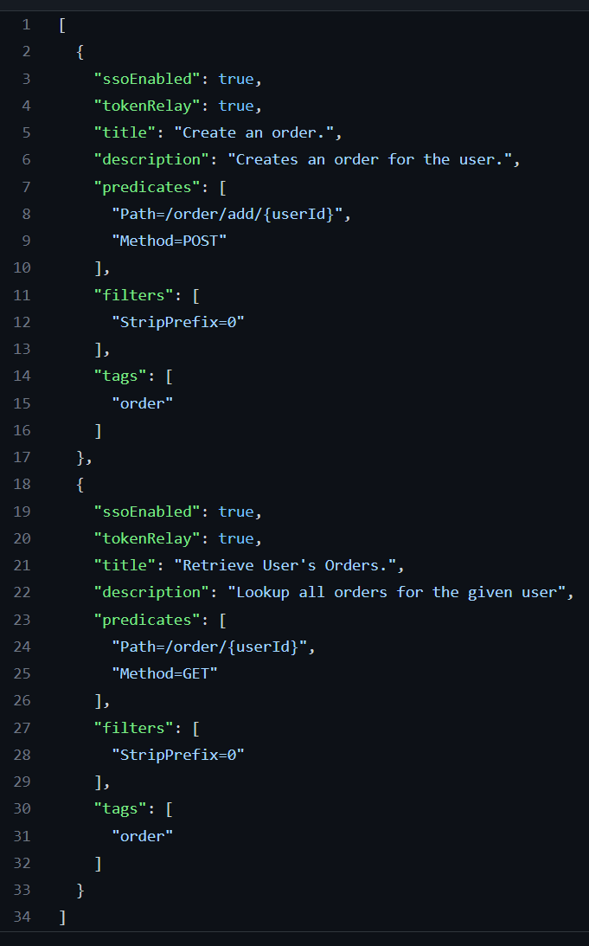
Single sign-on authorized endpoint – Security
Route filter
The SSO-enabled filter will force the client to be authenticated before allowing access to a route.
If the client is not authenticated, they will receive a 302 HTTP response with redirect URL to API Gateway’s configured SSO login page.
Ex: The /api/adopt route has the SSO-enabled filter enabled, when accessed through an HTTP GIT request.
Link to SSO Filters
Notes:
Behind the scenes, when we configured, we used the Single Sign-On Authorized Endpoint Security Filter.
When the filter is in action, it forces clients to be authenticated before accessing a route.
If the client is not authenticated, they will receive a 302 HTTP response with redirect to the Gateway’s configured Single Sign-On Login Page, in this case, it is the Azure Active Directory.
You can see the configuration on the right-hand side, particularly lines 21 and 22 in the JSON view.
Of course, you can configure Single Sign-On using the preferred identity provider of your choice.

Slide 9
Check in 2 – Review learnings
5 mins
Notes:
Speaker: Asir

Slide 10
5 min break

Slide 11
Part 3
Modern end-to-end path to production
Notes:
Speaker : Asir

Slide 12
Observability Observability patterns – traces, metrics, logs, and health checks
10 mins

Slide 13
Services depend on each other to deliver functionality
B
D
A
C
F

Slide 14
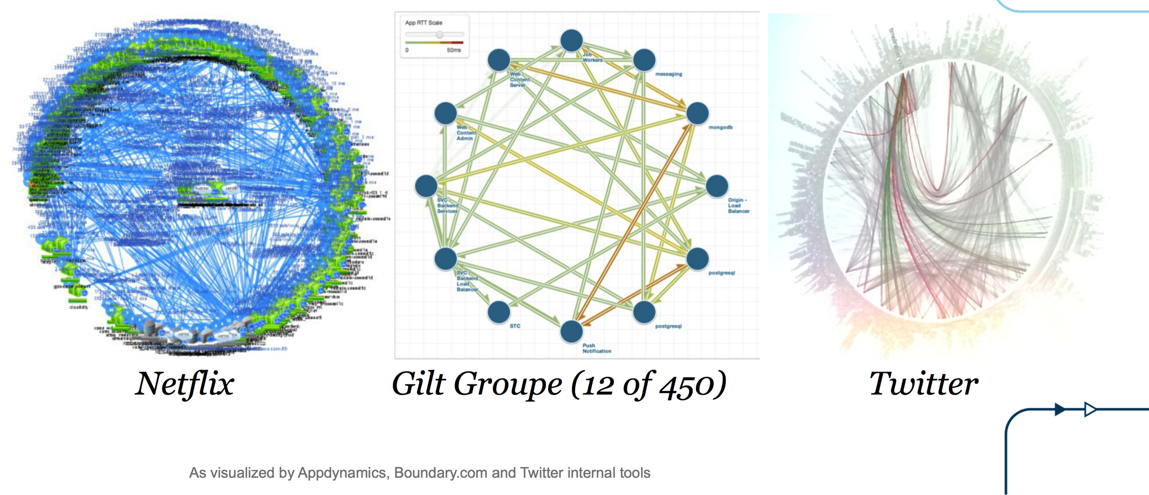
Death Star Architecture
Source: http://www.slideshare.net/adriancockcroft/goto-berlin

Slide 15
How can we pinpoint the root cause of a problem in a group of services?

Slide 16




Four types of observability
Logging
Health Checks
Metrics
Distributed Tracing

Slide 17
Four types of observability
Logging
Health Checks
Metrics
Distributed Tracing

Slide 18
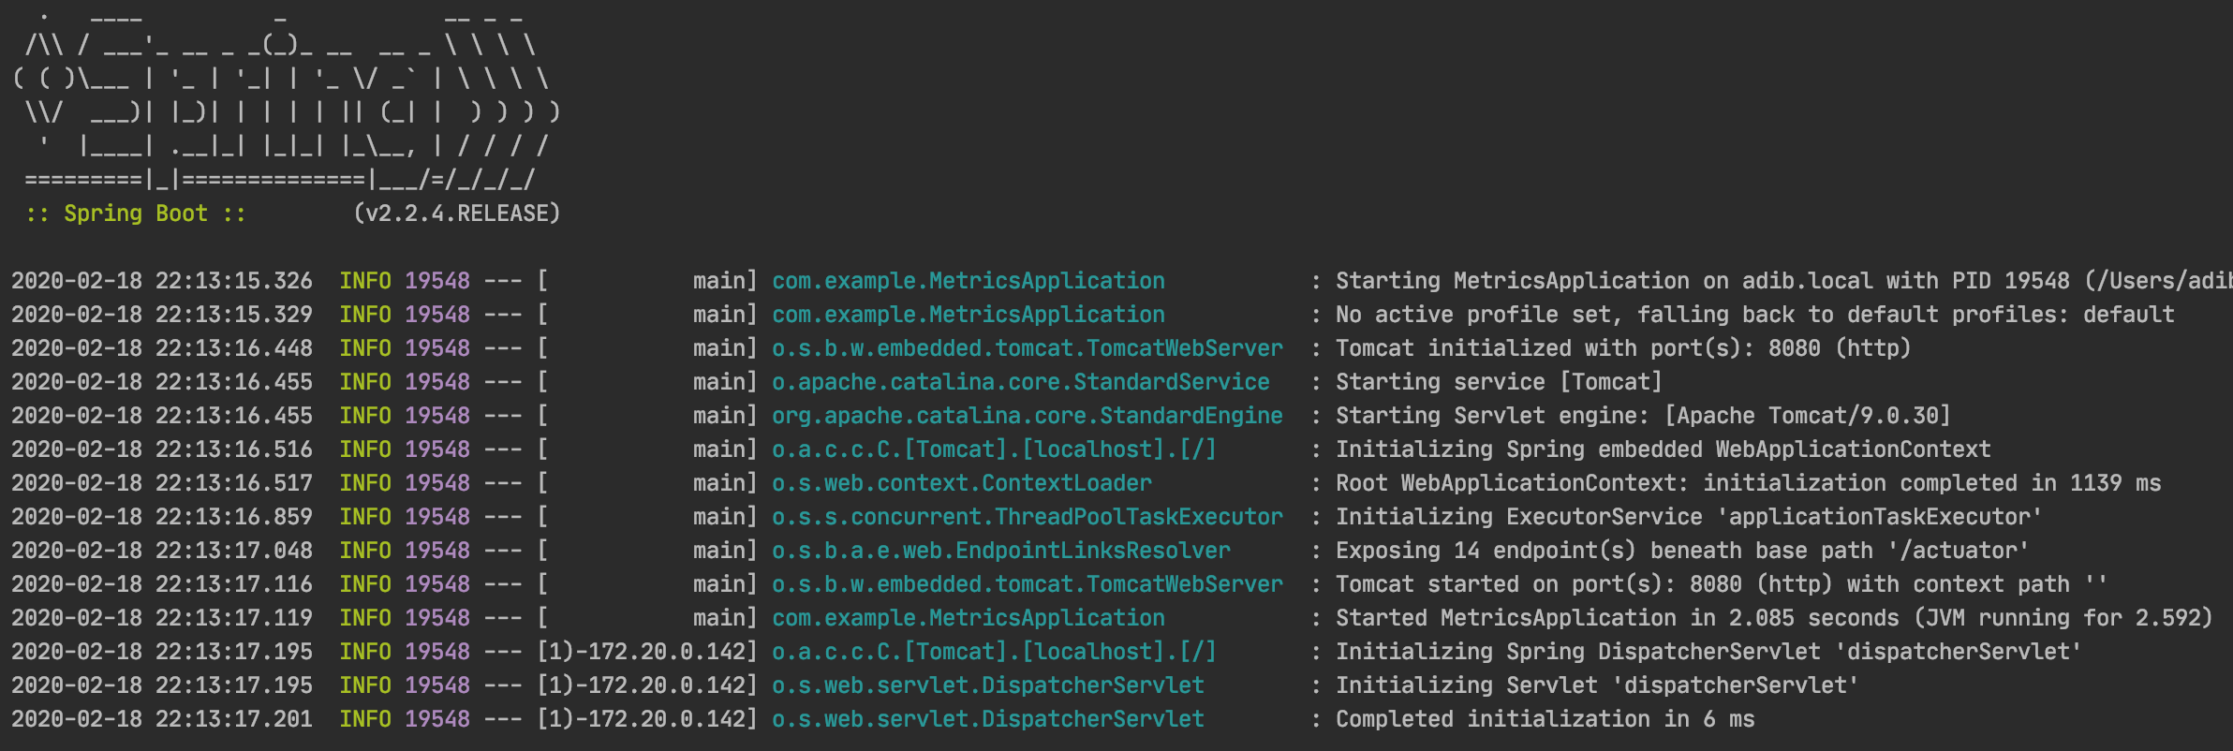
Traditional logging
Unstructured logs are hard to query and search through, since there is no standard format for the file.
Not possible to tell from the log statements what version of the code wrote the statement.

Slide 19
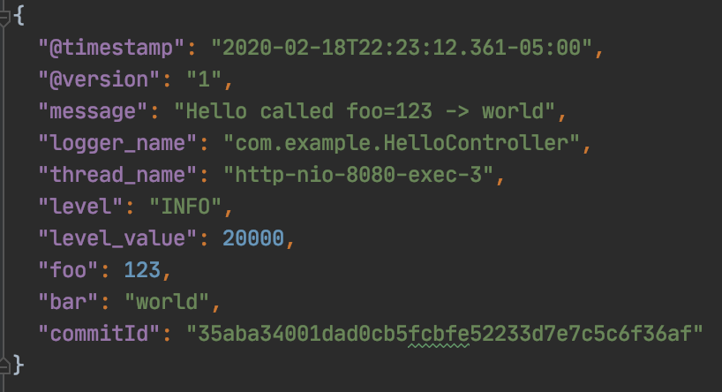
Structured Logging
Structured logs are written using a well-known format such as JSON that is easy to index and query.
Adding the git commit id to every log event makes it possible to determine precisely which version of the code wrote the log message.

Slide 20

Logging Demo

Slide 21
Four types of observability
Logging
Health Checks
Metrics
Distributed Tracing

